Slide 1


Cortical theta oscillations determine auditory channel capacity Oded Ghitza Boston University
Funded by a research grant
from

Slide 2
auditory channel capacity

Slide 3
Miller, G. A. (1956). The magical number 7±2:
some limits on our capacity for processing information

Slide 4
Miller, G. A. (1956). The magical number 7±2:
some limits on our capacity for processing information

Slide 5
Miller, G. A. (1956). The magical number 7±2:
some limits on our capacity for processing information

Slide 6
two possible interpretations

Slide 7
two possible interpretations

Slide 8
two possible interpretations

Slide 9
Shannon’s framework

Slide 10
Shannon’s derivation of capacity

Slide 11
first interpretation of Miller’s study

Slide 12
Miller 1st interpretation

Slide 13
Miller 1st interpretation

Slide 14
this talk is concern with:

Slide 15
material and subjects

Slide 16
auditory-channel/auditory-receiver – working hypothesis
*
* view “THE THETA-SYLLABLE” Demo movie

Slide 17
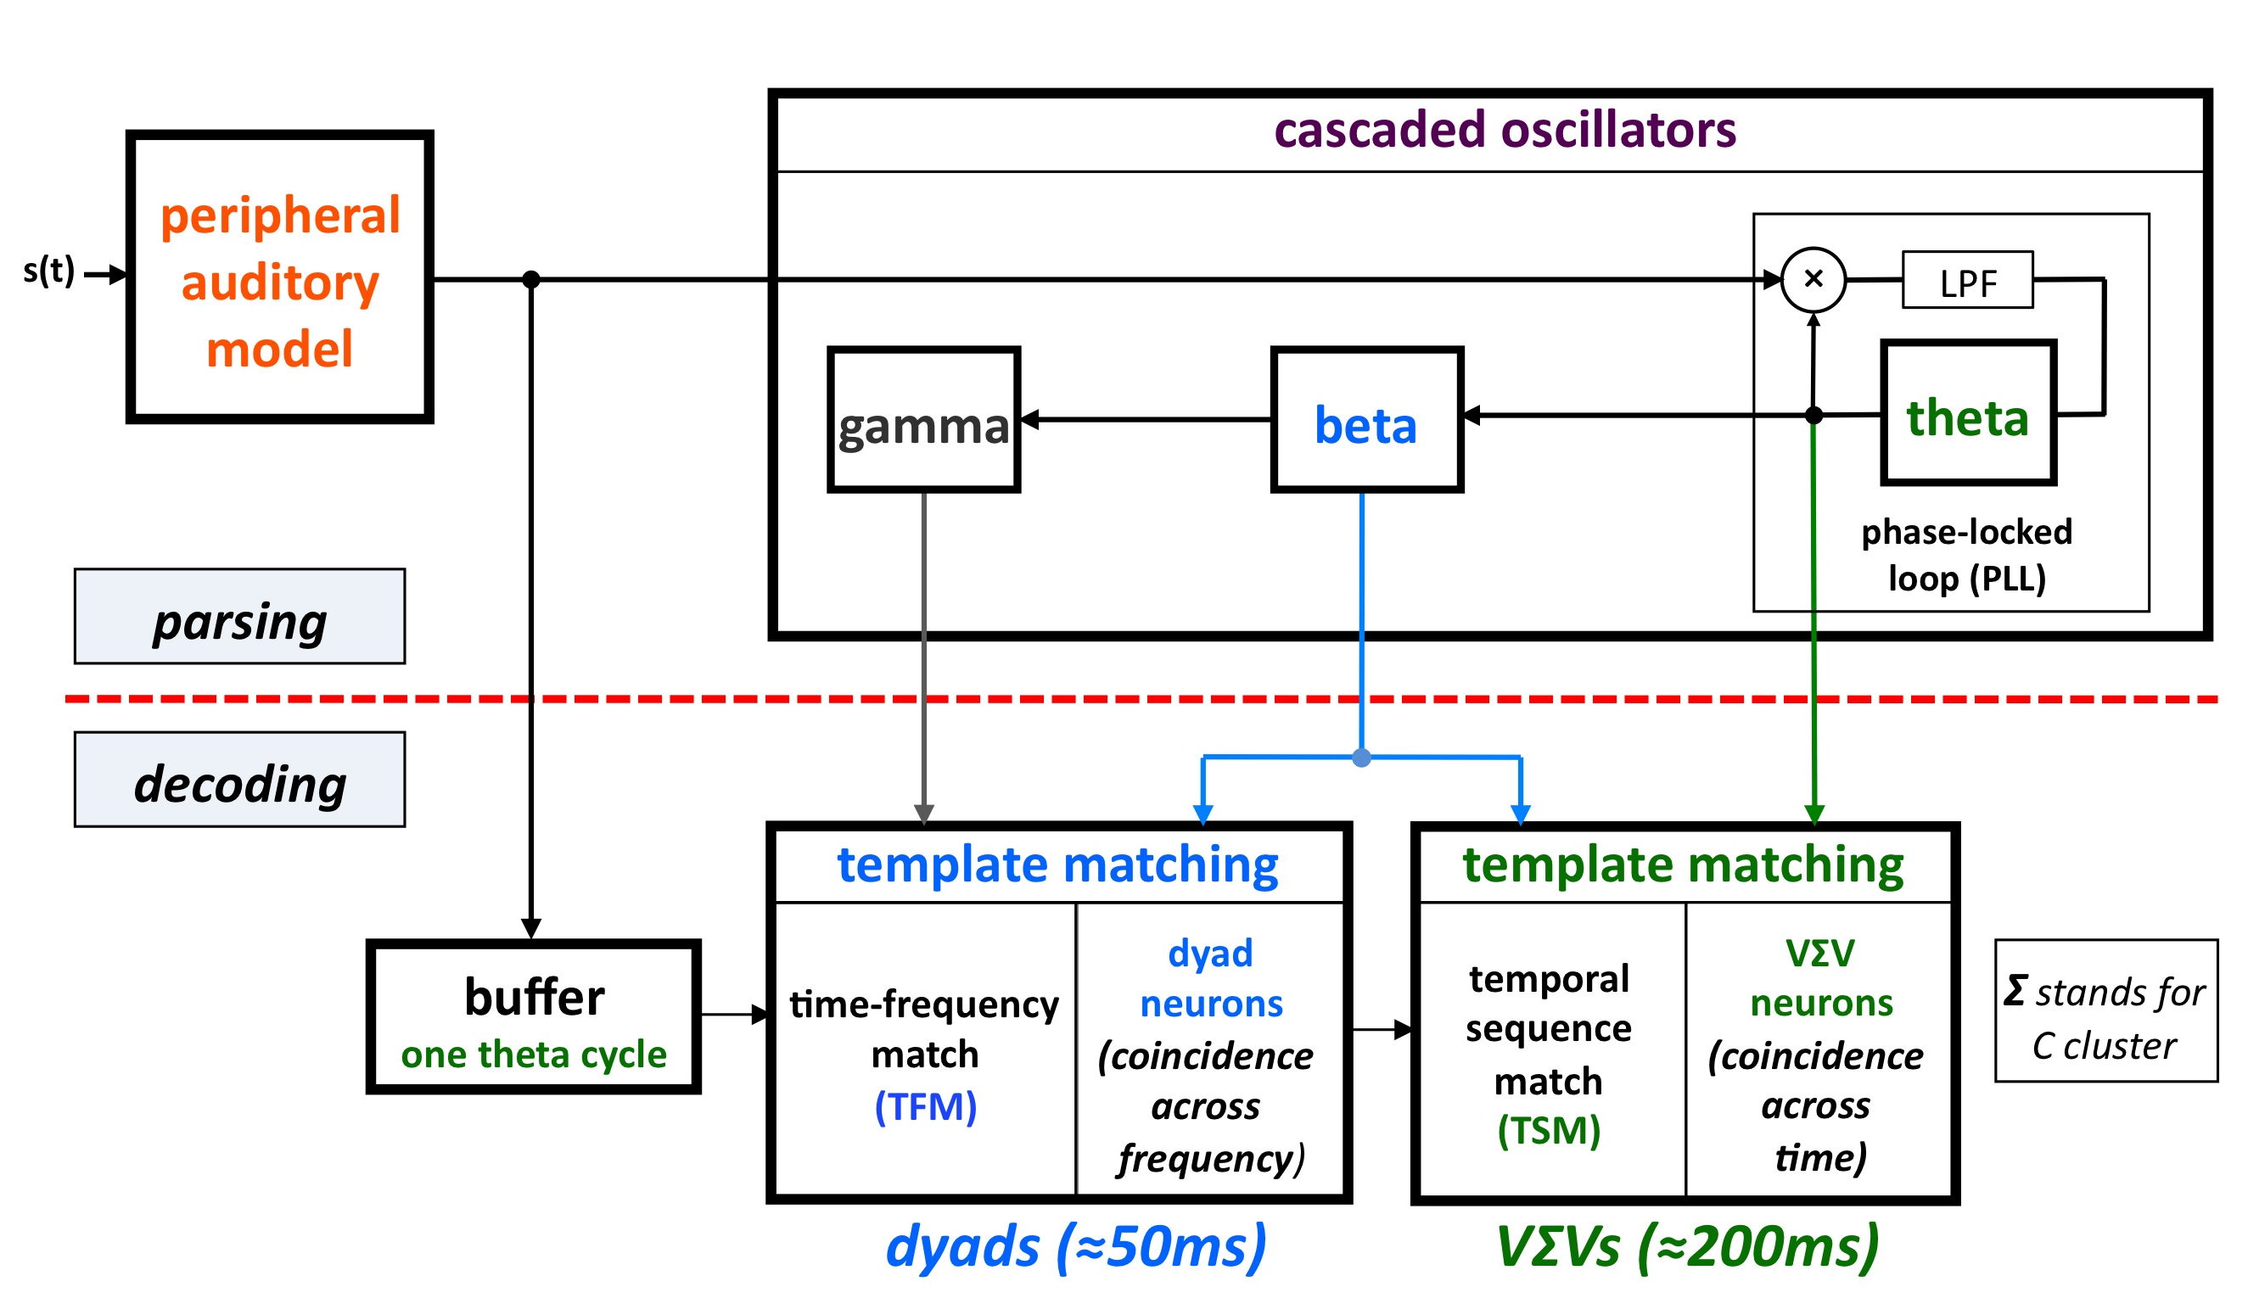
Tempo: a model of pre-lexical processing
Ghitza, 2011
decoding path:
conforms to conventional models of speech perception
parsing path
core concept: hierarchical window structure, synchronized with input ～ routing
mechanism: cascading oscillators locked to the input pseudo-rhythm
theta-cycle is the master window (aligned with VΣV)

Slide 18
psychophysical implementation of Shannon’s derivation

Slide 19
A few definitions first

Slide 20
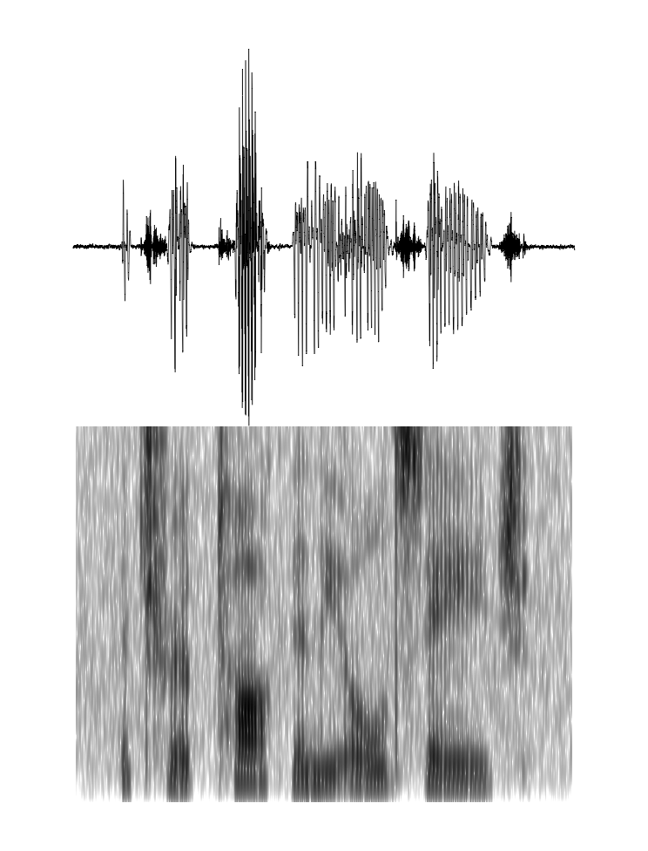
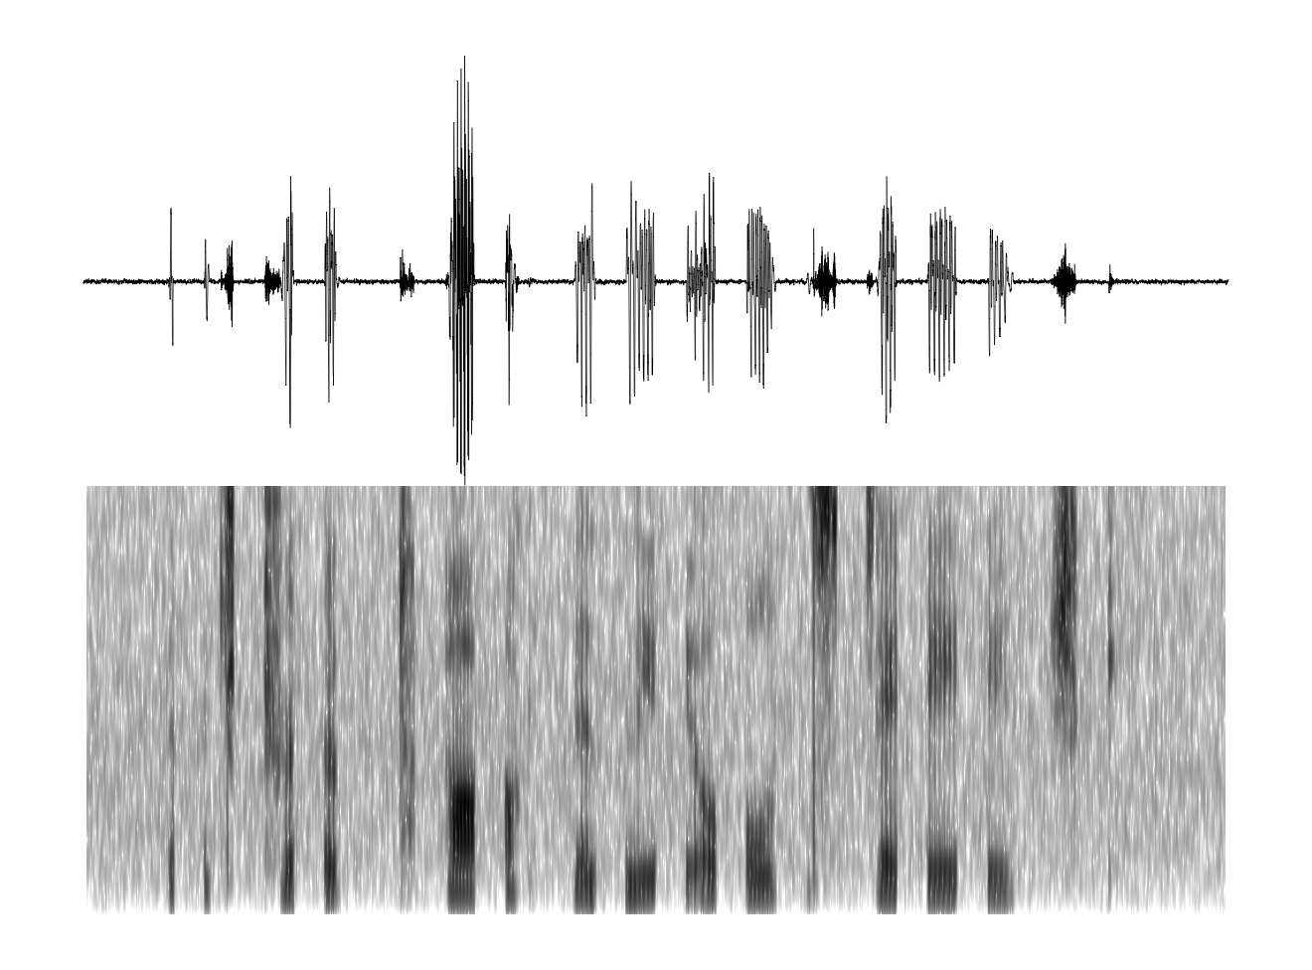
repackaging of time-compressed speech synthesis paradigm
time-compressed by 3
Δ
δ
time-compressed by 3, repackaged

Slide 21
Articulated Speech Information (ASI)
nothing to do with perception

Slide 22
Articulated Speech Information (ASI)
nothing to do with perception

Slide 23
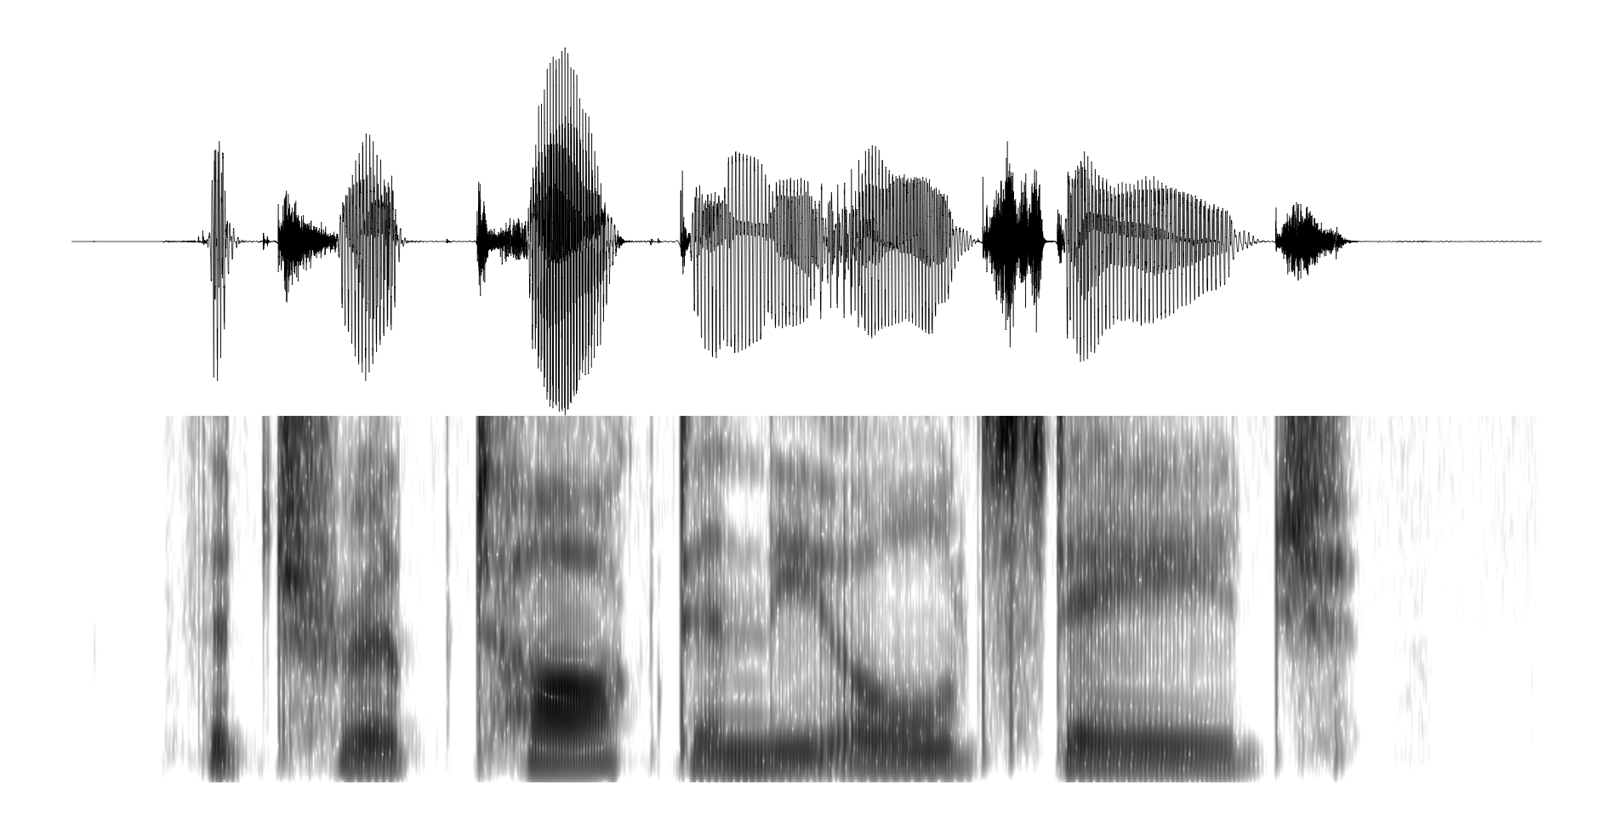
ASI – illustration
κ = 1
κ = 3

Slide 24
ASI Rate & ASI𝝉 Rate
still nothing to do with perception

Slide 25
psychophysical implementation of Shannon’s derivation

Slide 26
we found, at a glance:

Slide 27
we conclude, at a glance

Slide 28
experiments

Slide 29
experiment outline

Slide 30
linear time compression (no gaps)

Slide 31
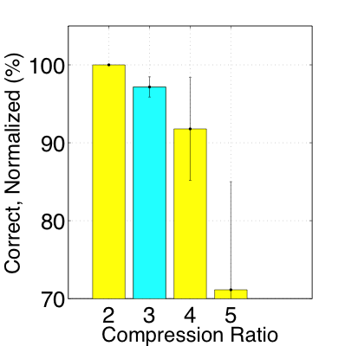
data

Slide 32
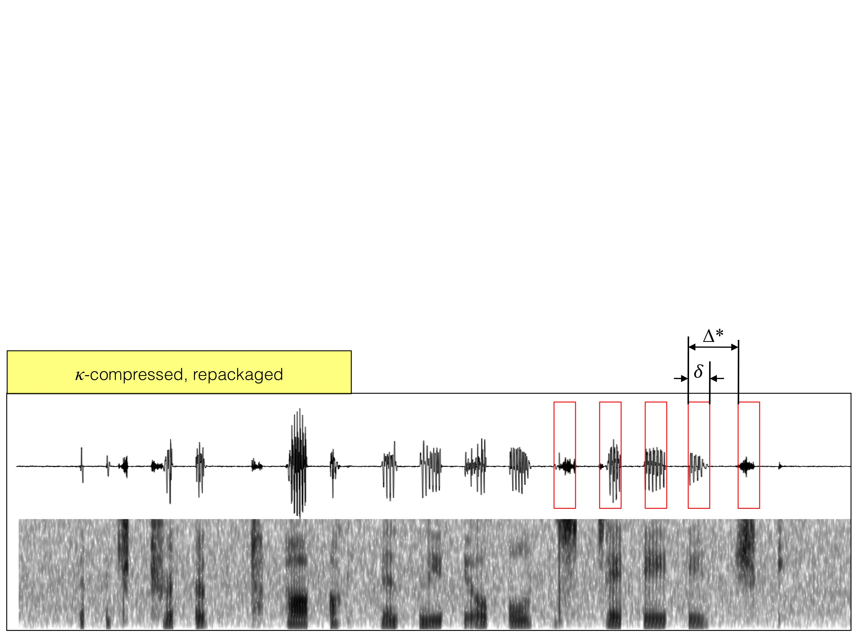
increase κ beyond κ*

Slide 33
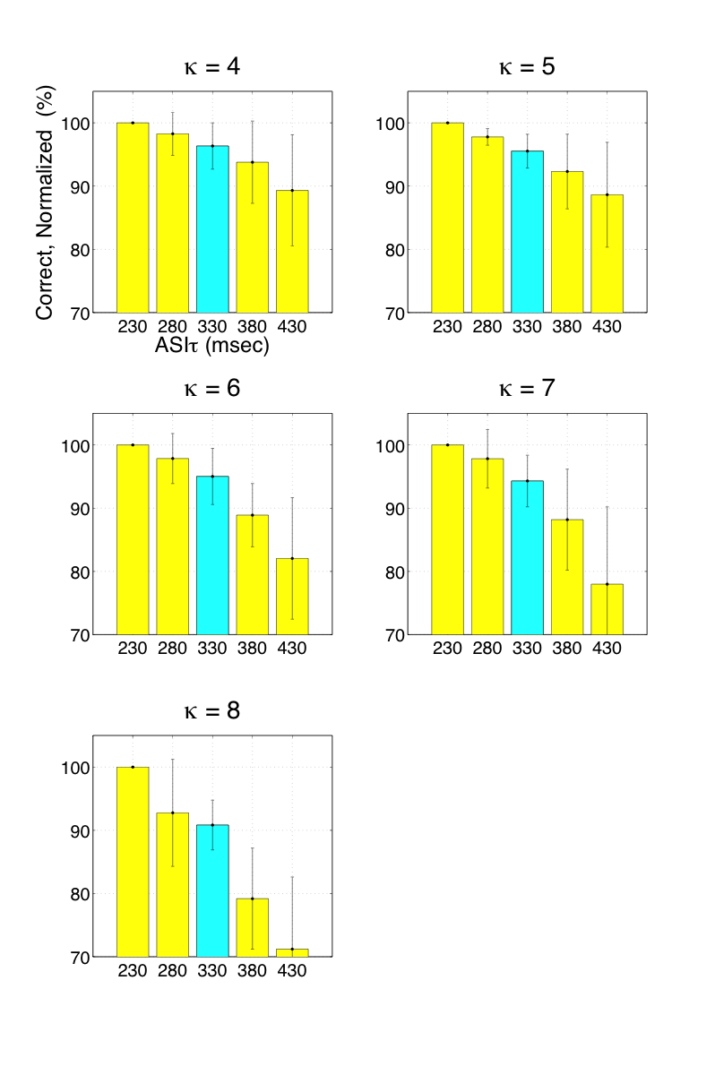
data

Slide 34
is R* auditory channel capacity?

Slide 35
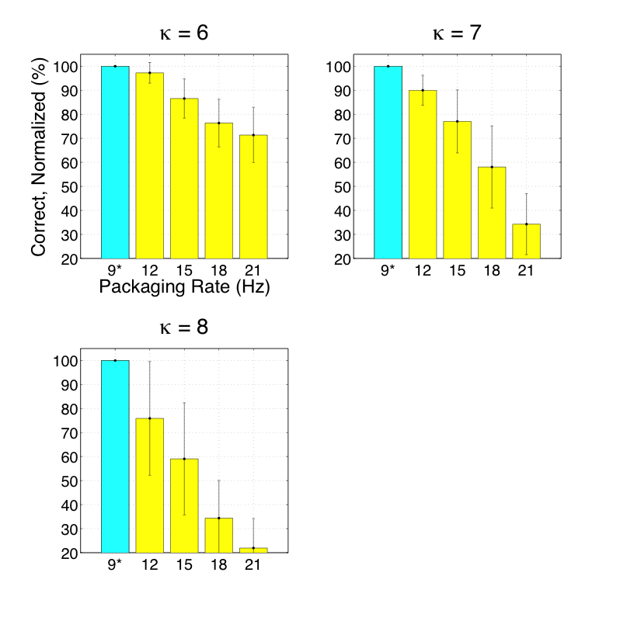
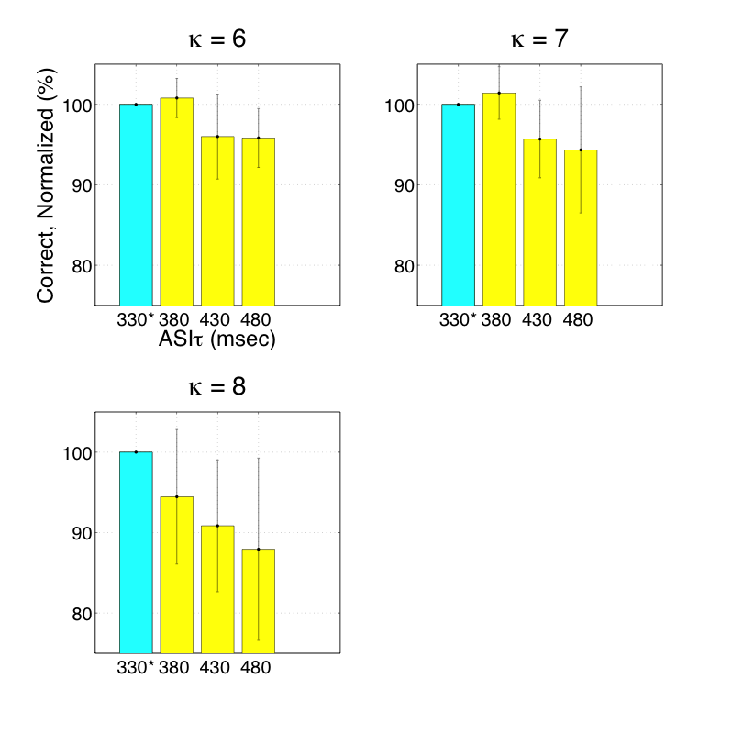
data

Slide 36
we found (in detail)

Slide 37
final thoughts

Slide 38
is the θ-cycle a cortical-time unit?

Slide 39
auditory channel capacity across languages

Slide 40
theta plays a central role in decoding speech, via parsing
Funded by a research grant
from

